Slide 1
LOGO CRAFT
GENERATING LOGO WITH DIFFUSION

Slide 2
Team : BUGBUSTERS
MULUKUTLA JAHNAVI
KEMIDI MANISH
SAHU AMRITHA KUMARI
MORLA MANISH

Slide 3
PROBLEM STATEMENT
In today's competitive market, establishing a memorable brand identity through a captivating logo is crucial for businesses.
However, many companies face challenges in creating unique and compelling logos that accurately represent their brand values and vision.
LogoCraft addresses this issue by leveraging cutting-edge Diffusion technology to generate custom logos based on user-provided descriptions.
By offering a seamless interface and intuitive controls, LogoCraft empowers businesses of all sizes to effortlessly create professional-grade logos that resonate with their target audience.
This project aims to revolutionize the logo design process, enabling businesses to stand out in a crowded marketplace and make a lasting impression on their customers

Slide 4
LogoCraft: Innovative Logo Generation with Diffusion Technology
What is logo generation ?
What is Diffusion Technology?
. the process of creating a unique and visually appealing logo, which is a graphic symbol or emblem that represents a brand, company, organization, or individual.
A logo is a critical element of branding, as it helps establish identity, build recognition, and convey the values or personality of the entity it represents.
Diffusion Technology is a cutting-edge approach in the field of generative artificial intelligence (AI) that focuses on creating high-quality, realistic outputs, such as images, logos, or other visual content.
It is based on diffusion models, which are a class of generative models that iteratively refine random noise into meaningful and coherent outputs.

Slide 5




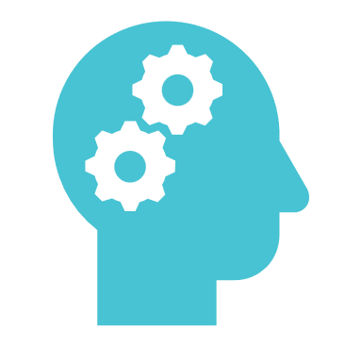
Here are the main tools and libraries used in your project:
DIFFUSERS
Library for diffusion models, used to load and run the Stable Diffusion model.
*TRANSFORMERS
- Provides the infrastructure and pre-trained models for natural language processing tasks.
SCIPY
A scientific computing library used for various mathematical functions and algorithms.
TORCH(PYTORCH)
- An open-source deep learning framework used for GPU acceleration and model inference.
PIL (PYTHON IMAGING LIBRARY)*:
- A library for image processing, used to handle and save the generated images.

Slide 6
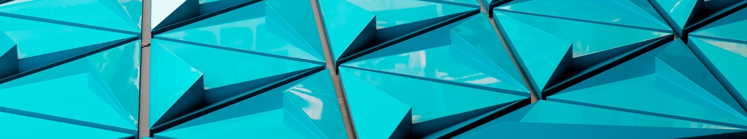
Here are the main tools and libraries used in your project:
*Hugging Face CLI*:
- Used for authentication and accessing pre-trained models from Hugging Face's model hub
*Jupyter Notebook / Google Colab*:
- Interactive environments for writing, running code, and displaying images.

Slide 7
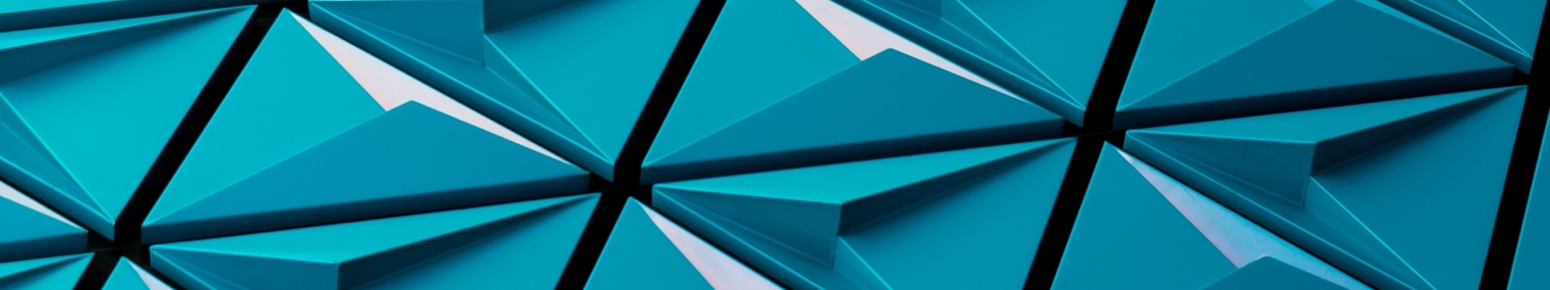
GITHUB LINK
https://github.com/Manish-072/LogoCraft/blob/main/LOGOCRAFT.ipynb

Slide 8
Here's a concise summary of the expected outcome of the project:
Enhanced Efficiency: The project will significantly streamline processes, resulting in improved productivity and reduced operational costs.
Increased Revenue: By targeting new markets and enhancing existing offerings, the project is anticipated to drive higher sales and revenue growth.
Customer Satisfaction: Implementing user-centric solutions will lead to a better customer experience, fostering loyalty and positive feedback.
Market Leadership: With innovative strategies and cutting-edge technology, the project aims to position the organization as a leader in its industry.

Slide 9
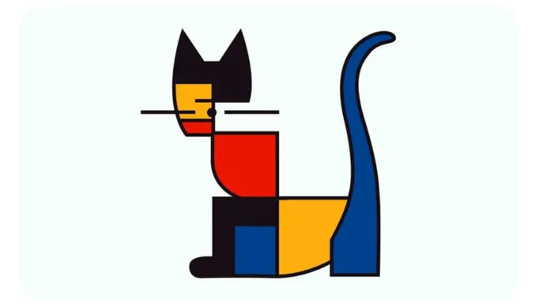
OUTPUT : GENERATED LOGO

Slide 10
Thank You

